Slide 1
MEMBERSHIP FEE
REVIEW PROJECT
CONSULTATION PACK

Slide 2
Welcome & agenda
Introduce WAGGGS colleagues
Background to the Membership Fee Review Project
Membership Fee Consultation Pack
Principles
Current model and other potential models
Additional considerations
Feedback and questions
Next steps

Slide 3
What is wagggs?
Our Mission is: To enable girls and young women to develop their fullest potential as responsible citizens of the world.
Our Vision is: An equal world where all girls can thrive.
By 2032 we will be a girl-led Movement where every and any girl feels confident to lead and empowered to create a better world together.
We refer to our vision as Compass 2032 and it is understood as a shared responsibility across all Girl Guide and Girl Scout organisations.

Slide 4

HOW wagggs SUPPORTS THE MOVEMENT
Purpose
Everything WAGGGS does must lead the Movement towards Compass 2032.
Priorities
WAGGGS prioritises three areas MOs most want WAGGGS to focus on:
Principles
Facilitating collaboration; volunteer-driven; wide reaching; responsible impact; girl and young women-led; realistic and transparent

Slide 5
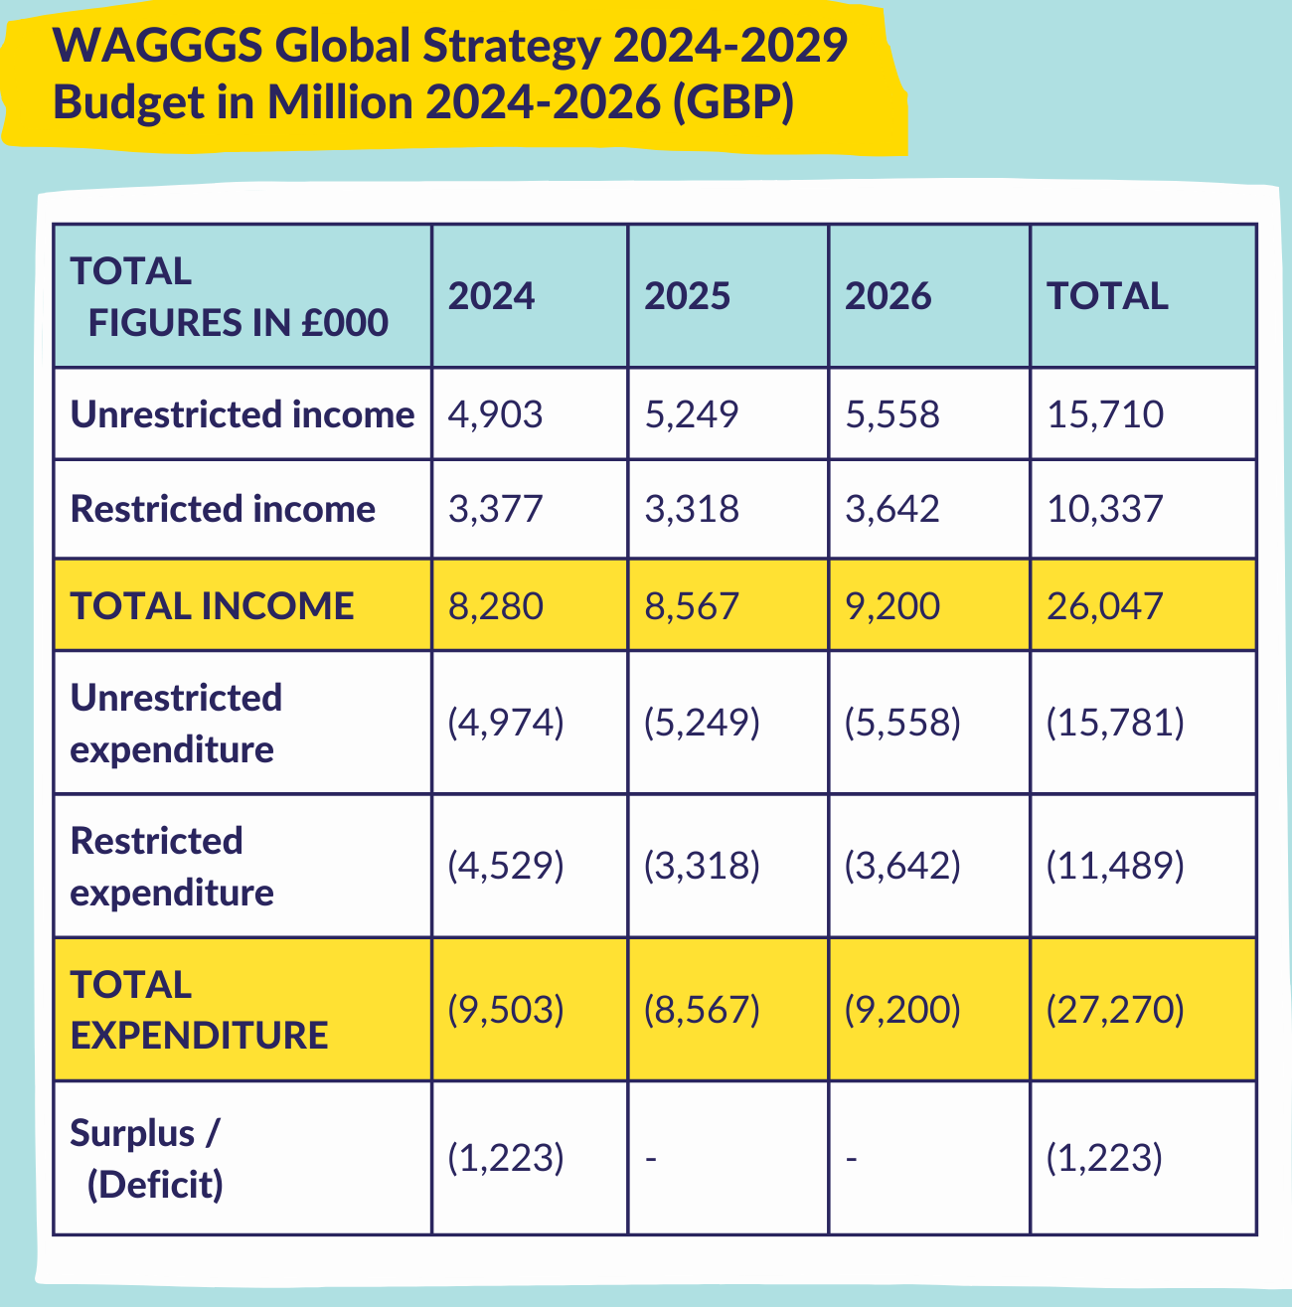
Wagggs’s budget

Slide 6
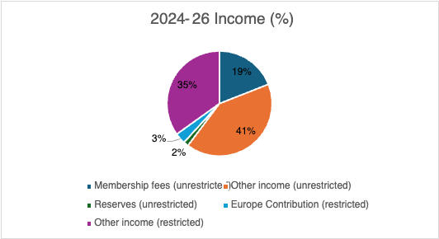
INCOME SOURCES

Slide 7
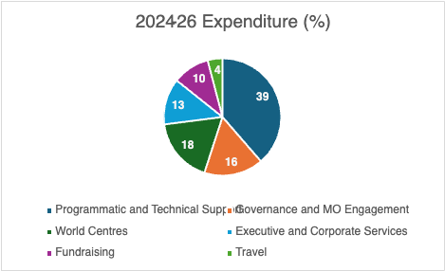
AREAS OF EXPENDITURE

Slide 8
Membership fee consultation pack
The consultation pack:
Reminds us of the Movement’s mission and how this is supported by WAGGGS’s offer, articulated in the Action Plan and Budget 2024-26
Summarises how membership fees support the Movement
Explores potential membership fee principles and options for new models

Slide 9
PRINCIPLES
Support the delivery of WAGGGS’s strategic objectives, in line with Compass 2032.
Contribute to WAGGGS’s financial viability as a membership organisation and reduce WAGGGS‘s financial reliance on any single MO
Provide a more equitable membership fee structure that responds to MO needs
Continue to be transparent and provide an objective framework for fee calculation
Be designed so that it can be applied on a long-term basis; with the ability to make adjustments within an agreed framework

Slide 10
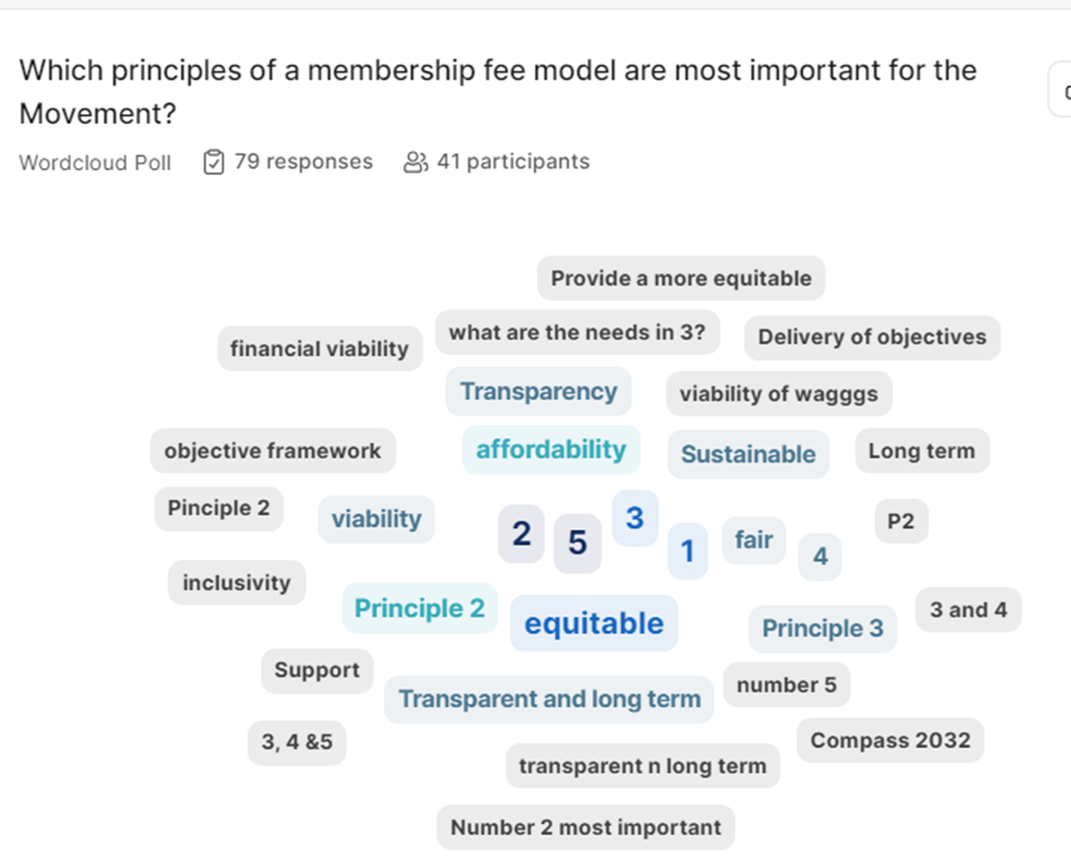
Word Cloud results
English session 2

Slide 11
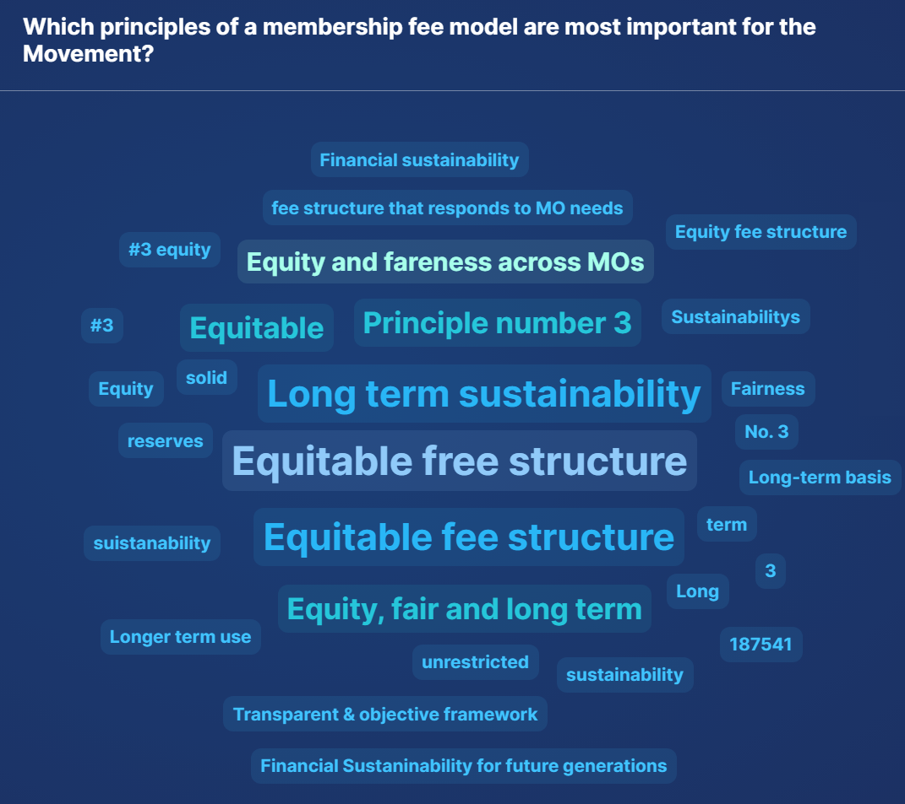
Word Cloud results
English session 4

Slide 12
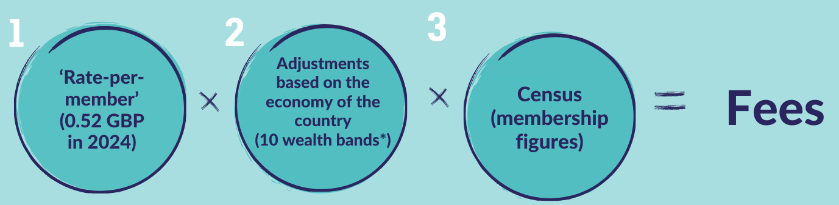
CURRENT MODEL / MODEL 1

Slide 13
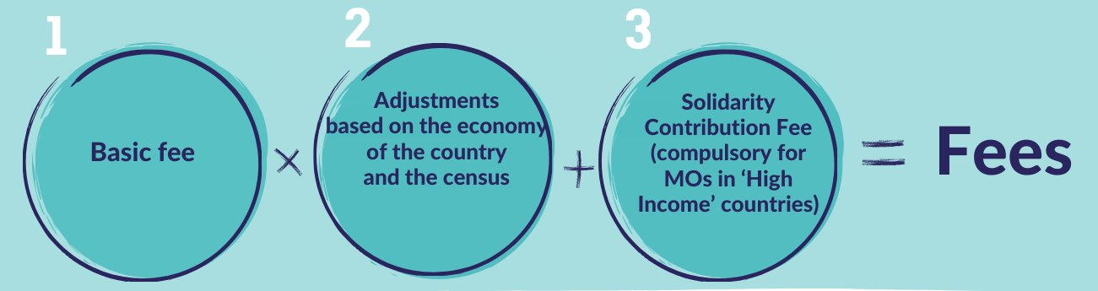
MODEL 2

Slide 14
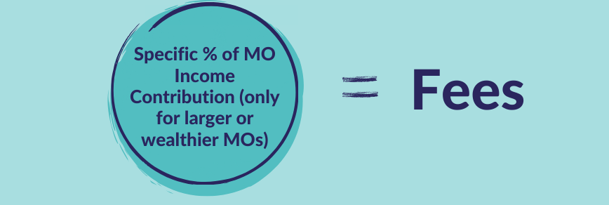
MODEL 3

Slide 15
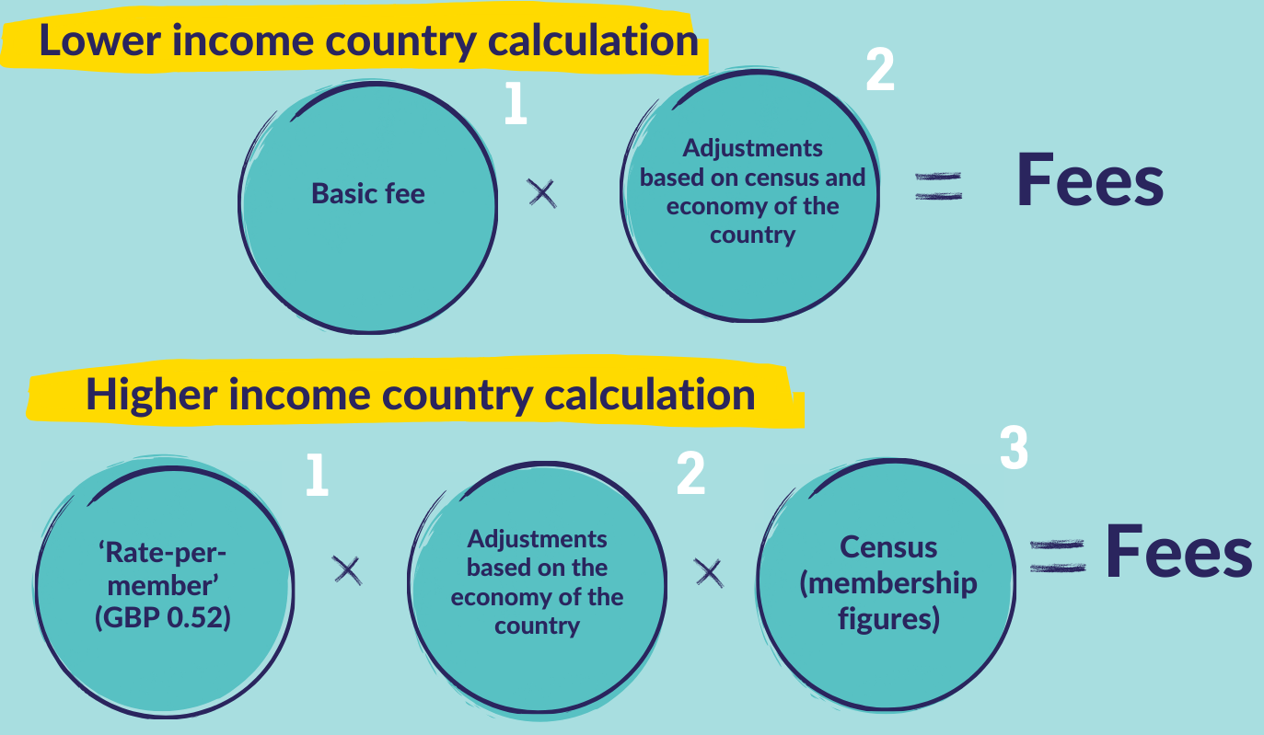
MODEL 4

Slide 16
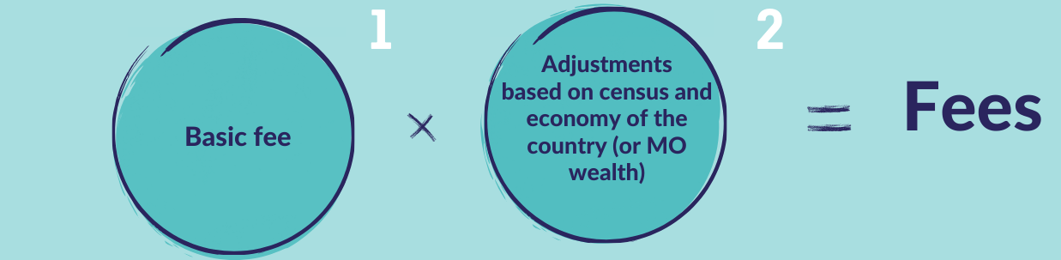
MODEL 5

Slide 17
ADDITIONAL CONSIDERATIONS
1. Minimum fees
2. Reduction for Associate Members
3. Reduction for large MOs from WAGGGS wealth bands B-D
4. No MO pays more than 55% of the total
5. Transitional relief

Slide 18
EXAMPLE
Model | 1 | 2 | 3 | 4 | 5
Membership Fee (GBP) of Example 1 | 27,927 | 26,823 | 58,345 | 27,927 | 30,000
Membership Fee (GBP) of Example 2 | 170 | 174 | 174 | 350 | 350

Slide 19
BREAKOUT ROOM:
DISCUSSION OF CURRENT AND FUTURE MODELS
Which aspects of the current model (Model 1) do you want to keep and which would you like to change?
Which of the new potential models did you like best, and why?
Are there any other models or method adjustments that you think should be considered?

Slide 20


Slide 21
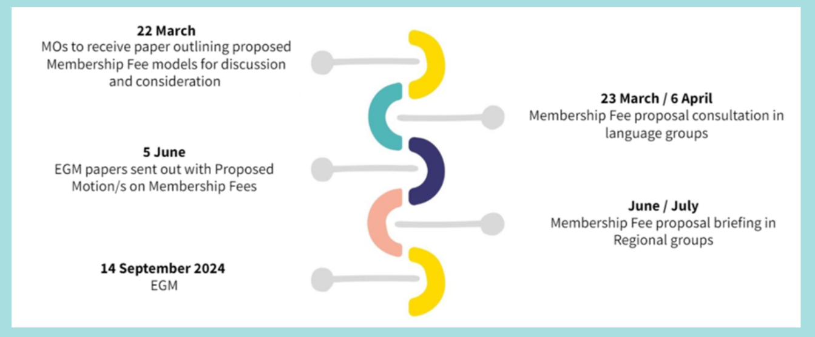
NEXT STEPS – journey to egm

Slide 22



Feedback and questions

Slide 23
WAGGGS

